Slide 1
SINGULAR VALUE DECOMPOSITION FOR DATA COMPRESSION
N. THAMPIRAJ
RESEARCH SCHOLAR
DEPARTMENT OF MATHEMATICS
PSG COLLEGE OF TECHNOLOGY

Slide 2
The objective of the research work is
To discover patterns in data and make predictions based on often complex patterns.
To Implement, analyze and improvise existing learning algorithms, for classification, regression, structured prediction, clustering, etc.
To develop new learning methods.

Slide 3
Scope
In the past decade, data explosion is a common phenomenon in several industries like health care, finance, marketing.
Linear algebra and the optimization techniques plays a key role in leveraging the big data to enhance the existing industry by solving various existing problems.

Slide 4
Road Map
Data Compression
Singular Value Decomposition
SVD in Recommender Systems
SVD in Image Compression
References

Slide 5
Data Compression
Data Compression is the technique used to reduce the size of data by removing number of bits.
Data Compression includes numbers, text, images, video, audio.
Need for Data Compression
In satellite images , image compression is used for three main reasons.
Saves space - Satellite receives millions of bits of data each day that require a huge storage facility. By using compression, saves an enormous amount of hard drive space.
Saves transmission time - Mars Rovers send back pictures and data which can take up to years to send if uncompressed due to the massive distance between Mars and Earth.
Saves money - Hard drive space and time.

Slide 6
Image Compression Techniques
The following techniques are used for image compression.
Discrete Cosine Transform (DCT)
Discrete Wavelet Transform (DWT)
Singular Value Decomposition (SVD)
Principal Component Analysis (PCA)
Support Vector Machine (SVM)

Slide 7
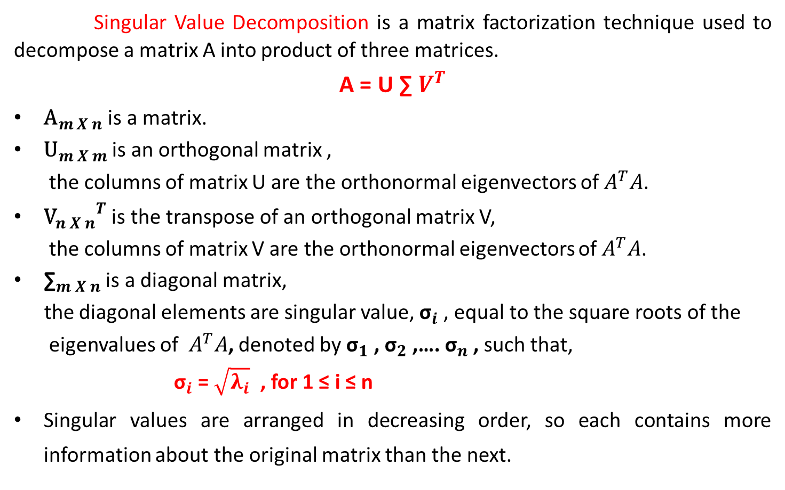
Singular Value Decomposition
Singular Value Decomposition is a matrix factorization technique used to decompose a matrix A into product of three matrices.
A = U ∑ $V^{T}$
${\text{A}}_{m X n}$ is a matrix.
${\text{U}}_{m X m}$ is an orthogonal matrix ,
the columns of matrix U are the orthonormal eigenvectors of $A^{T}A$.
${{\text{V}}_{n X n}}^{T}$ is the transpose of an orthogonal matrix V,
the columns of matrix V are the orthonormal eigenvectors of $A^{T}A$.
${\text{∑}}_{m X n}$ is a diagonal matrix,
the diagonal elements are singular value, ${\text{σ}}_{i}$, equal to the square roots of the
eigenvalues of $A^{T}A$, denoted by ${\text{σ}}_{1}$, ${\text{σ}}_{2}$,…. ${\text{σ}}_{n}$, such that,
${\text{σ}}_{i}$= $\sqrt{λ_{i}}$ , for 1 ≤ i ≤ n
Singular values are arranged in decreasing order, so each contains more information about the original matrix than the next.

Slide 8
SVD in Recommender System
Recommender Systems are software tools and techniques providing suggestions for items to be of use to a user.
The suggestions related to various decision – making processes :
what items to buy
what music to listen
what movies to watch
The primary application of recommender systems is finding a relationship between user and products in order to maximize the user-product engagement.

Slide 9

SVD in Movie Recommendation - Example
User / Movies | Sci-Fi 1 | Sci-Fi 2 | Sci-Fi 3 | Comedy 1 | Comedy 2
User 1 | 1 | 1 | 1 | 0 | 0
User 2 | 3 | 3 | 3 | 0 | 0
User 3 | 4 | 4 | 4 | 0 | 0
User 4 | 5 | 5 | 5 | 0 | 0
User 5 | 0 | 2 | 0 | 4 | 4
User 6 | 0 | 0 | 0 | 5 | 5
User 7 | 0 | 1 | 0 | 2 | 2
$$A=\left[\begin{matrix}1 & 1 & 1 & 0 & 0 \\ 3 & 3 & 3 & 0 & 0 \\ 4 & 4 & 4 & 0 & 0 \\ 5 & 5 & 5 & 0 & 0 \\ 0 & 2 & 0 & 4 & 4 \\ 0 & 0 & 0 & 5 & 5 \\ 0 & 1 & 0 & 2 & 2\end{matrix}\right]$$

Slide 10
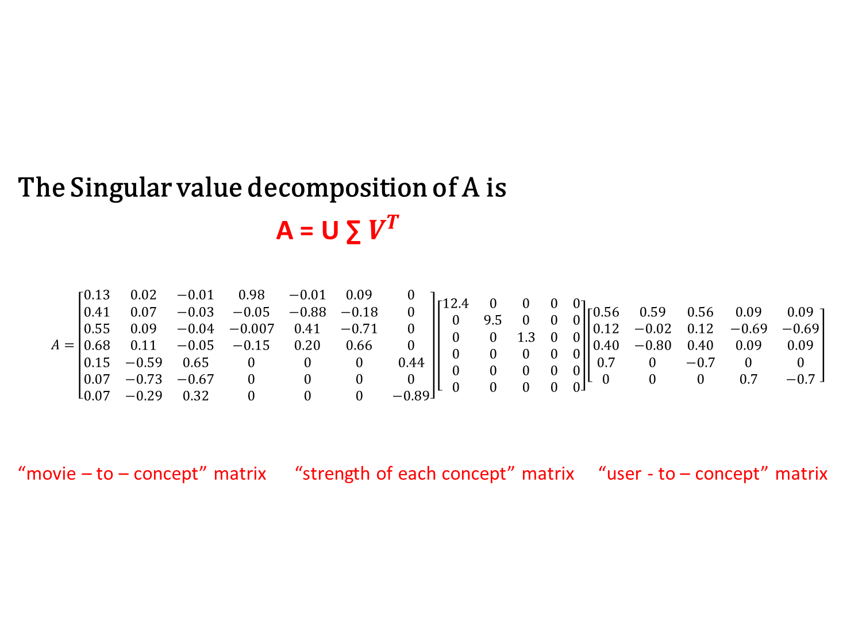
SVD in Movie Recommendation - Example
The Singular value decomposition of A is
A = U ∑ $V^{T}$
$$A=\left[\begin{matrix}0.13 & 0.02 & −0.01 & 0.98 & −0.01 & 0.09 & 0 \\ 0.41 & 0.07 & −0.03 & −0.05 & −0.88 & −0.18 & 0 \\ 0.55 & 0.09 & −0.04 & −0.007 & 0.41 & −0.71 & 0 \\ 0.68 & 0.11 & −0.05 & −0.15 & 0.20 & 0.66 & 0 \\ 0.15 & −0.59 & 0.65 & 0 & 0 & 0 & 0.44 \\ 0.07 & −0.73 & −0.67 & 0 & 0 & 0 & 0 \\ 0.07 & −0.29 & 0.32 & 0 & 0 & 0 & −0.89\end{matrix}\right]\left[\begin{matrix}12.4 & 0 & 0 & 0 & 0 \\ 0 & 9.5 & 0 & 0 & 0 \\ 0 & 0 & 1.3 & 0 & 0 \\ 0 & 0 & 0 & 0 & 0 \\ 0 & 0 & 0 & 0 & 0 \\ 0 & 0 & 0 & 0 & 0\end{matrix}\right]\left[\begin{matrix}0.56 & 0.59 & 0.56 & 0.09 & 0.09 \\ 0.12 & −0.02 & 0.12 & −0.69 & −0.69 \\ 0.40 & −0.80 & 0.40 & 0.09 & 0.09 \\ 0.7 & 0 & −0.7 & 0 & 0 \\ 0 & 0 & 0 & 0.7 & −0.7\end{matrix}\right]$$
“movie – to – concept” matrix “strength of each concept” matrix “user - to – concept” matrix

Slide 11

How is SVD Decomposition used to compress data?
Given matrix A(of rank m), what is the closest matrix ${\text{A}}_{k}$ (of rank k<m) to A?
$$A=UƩV^{T}=\sum_{i=1}^{m}{u_{i}σ_{i}{v_{i}}^{T}}$$
$A_{k} =u_{1}σ_{1}{v_{1}}^{T}$+ $u_{2}σ_{2}{v_{2}}^{T}+…+u_{k}σ_{k}{v_{k}}^{T}$

Slide 12
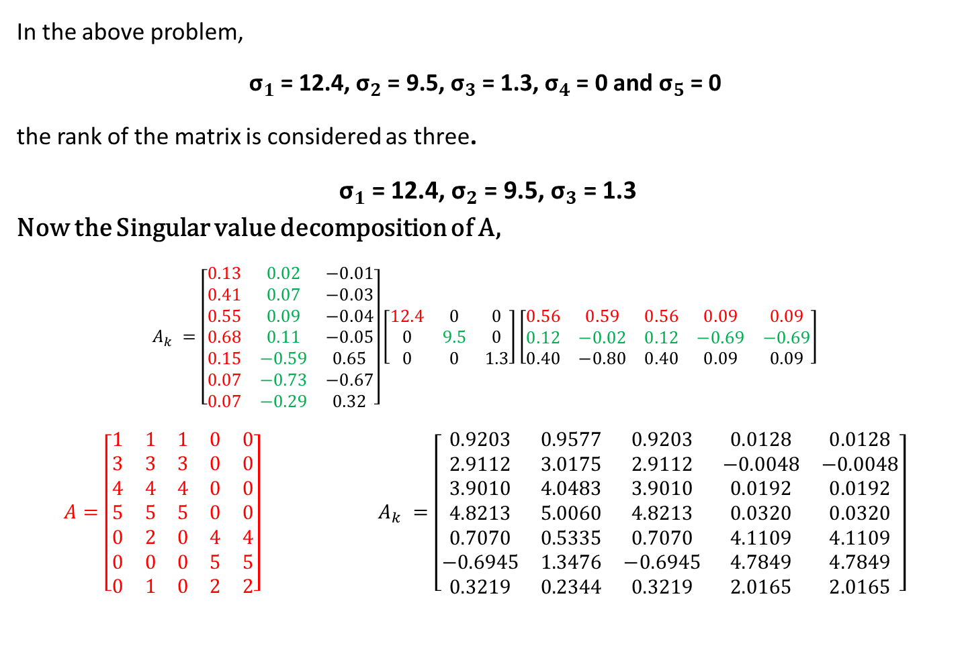
In the above problem,
${\text{σ}}_{1}$= 12.4, ${\text{σ}}_{2}$= 9.5, ${\text{σ}}_{3}$= 1.3, ${\text{σ}}_{4}$= 0 and ${\text{σ}}_{5}$= 0
the rank of the matrix is considered as three.
${\text{σ}}_{1}$= 12.4, ${\text{σ}}_{2}$= 9.5, ${\text{σ}}_{3}$= 1.3
Now the Singular value decomposition of A,
$$A_{k} =\left[\begin{matrix}0.13 & 0.02 & −0.01 \\ 0.41 & 0.07 & −0.03 \\ 0.55 & 0.09 & −0.04 \\ 0.68 & 0.11 & −0.05 \\ 0.15 & −0.59 & 0.65 \\ 0.07 & −0.73 & −0.67 \\ 0.07 & −0.29 & 0.32\end{matrix}\right]\left[\begin{matrix}12.4 & 0 & 0 \\ 0 & 9.5 & 0 \\ 0 & 0 & 1.3\end{matrix}\right]\left[\begin{matrix}0.56 & 0.59 & 0.56 & 0.09 & 0.09 \\ 0.12 & −0.02 & 0.12 & −0.69 & −0.69 \\ 0.40 & −0.80 & 0.40 & 0.09 & 0.09\end{matrix}\right]$$
$$A=\left[\begin{matrix}1 & 1 & 1 & 0 & 0 \\ 3 & 3 & 3 & 0 & 0 \\ 4 & 4 & 4 & 0 & 0 \\ 5 & 5 & 5 & 0 & 0 \\ 0 & 2 & 0 & 4 & 4 \\ 0 & 0 & 0 & 5 & 5 \\ 0 & 1 & 0 & 2 & 2\end{matrix}\right] A_{k} =\left[\begin{matrix}0.9203 & 0.9577 & 0.9203 & 0.0128 & 0.0128 \\ 2.9112 & 3.0175 & 2.9112 & −0.0048 & −0.0048 \\ 3.9010 & 4.0483 & 3.9010 & 0.0192 & 0.0192 \\ 4.8213 & 5.0060 & 4.8213 & 0.0320 & 0.0320 \\ 0.7070 & 0.5335 & 0.7070 & 4.1109 & 4.1109 \\ −0.6945 & 1.3476 & −0.6945 & 4.7849 & 4.7849 \\ 0.3219 & 0.2344 & 0.3219 & 2.0165 & 2.0165\end{matrix}\right]$$

Slide 13
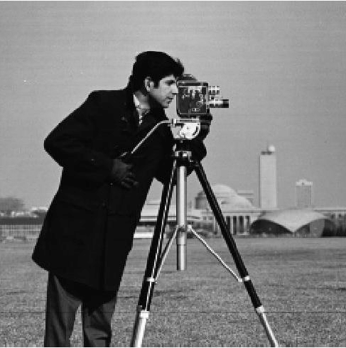
SVD in Image Compression
The size of the ‘img’ file is 256 X 256 and storage space for the image file is 65,536 mega pixels.

Slide 14
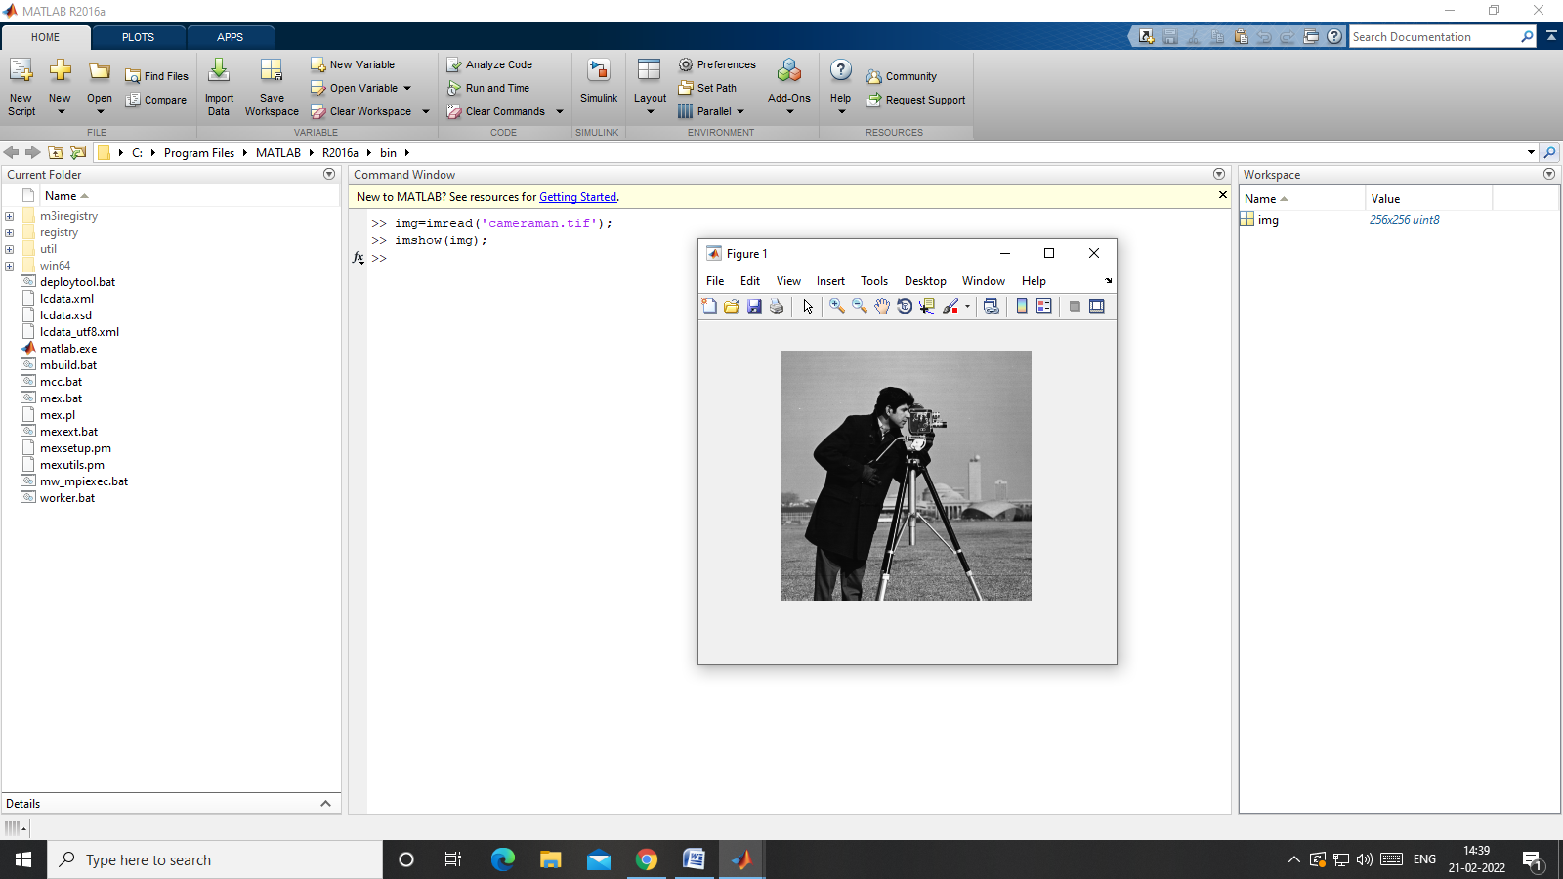
Original Image

Slide 15
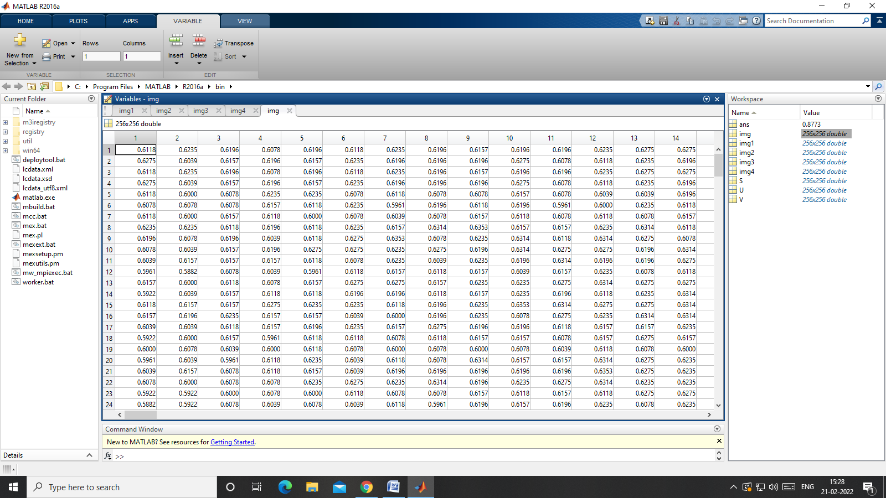
Pixel Values

Slide 16
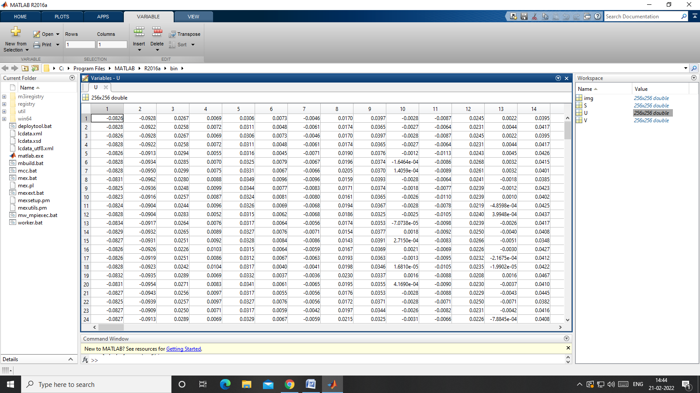
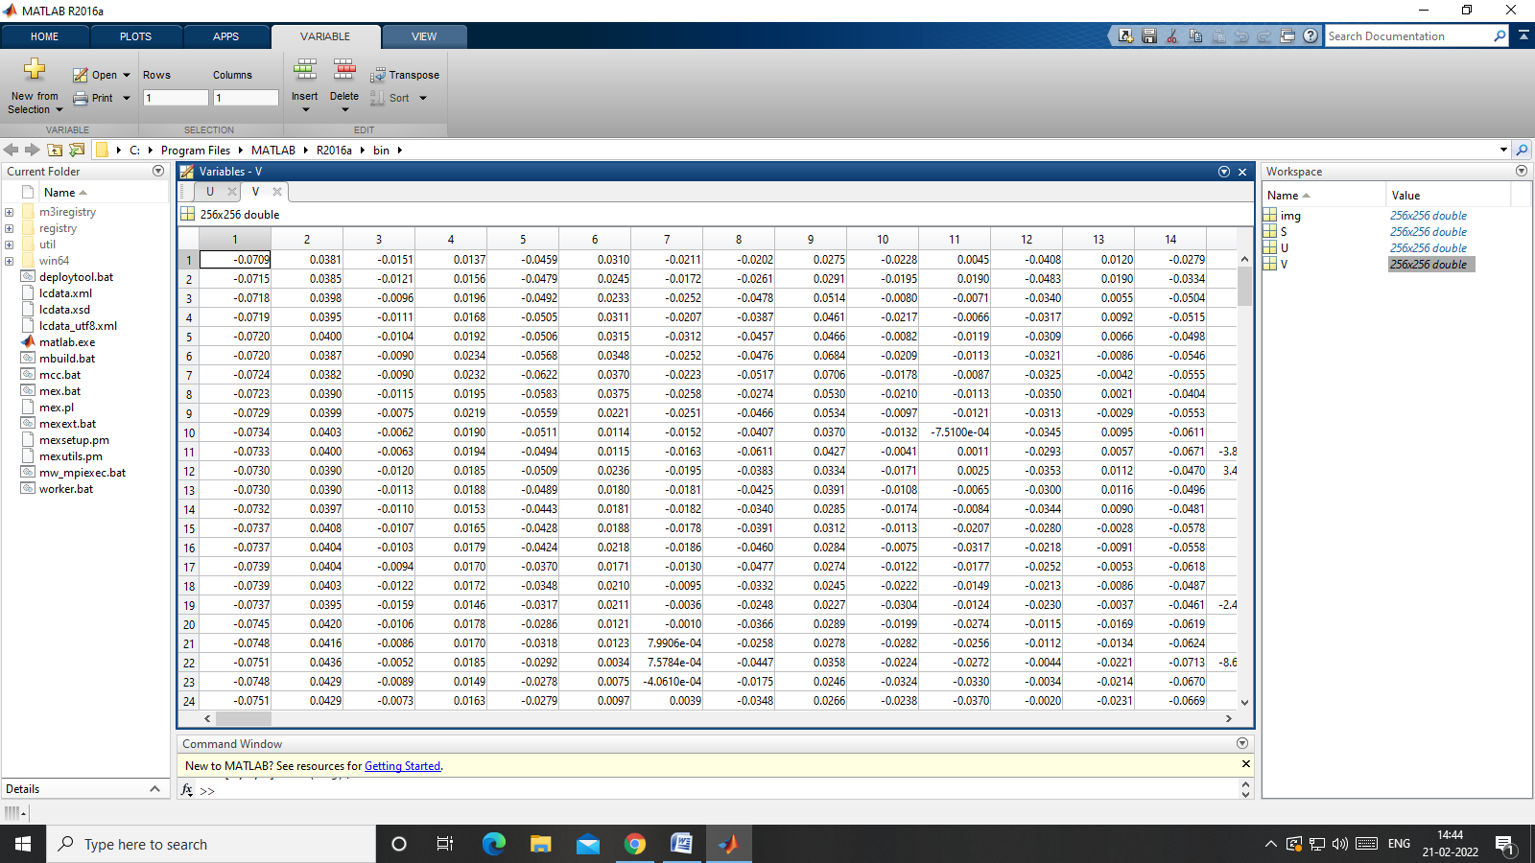
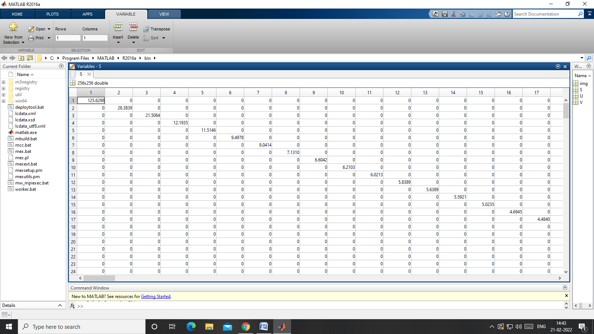
Singular Value Decomposition

Slide 17
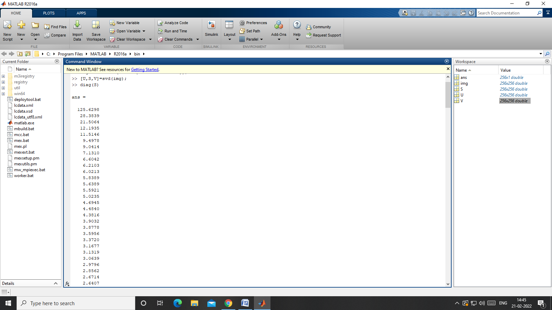
Singular Values

Slide 18
Singular Values

Slide 19
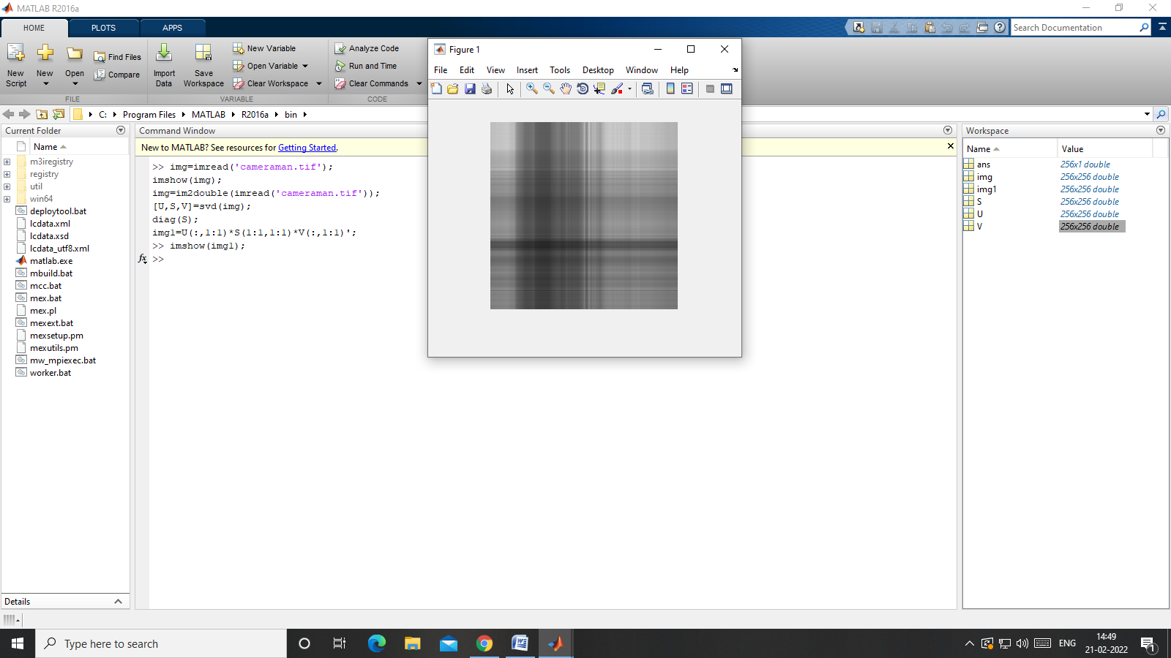
Rank(img) = 1, (k=1)

Slide 20

Rank(img) = 1, (k=1)

Slide 21
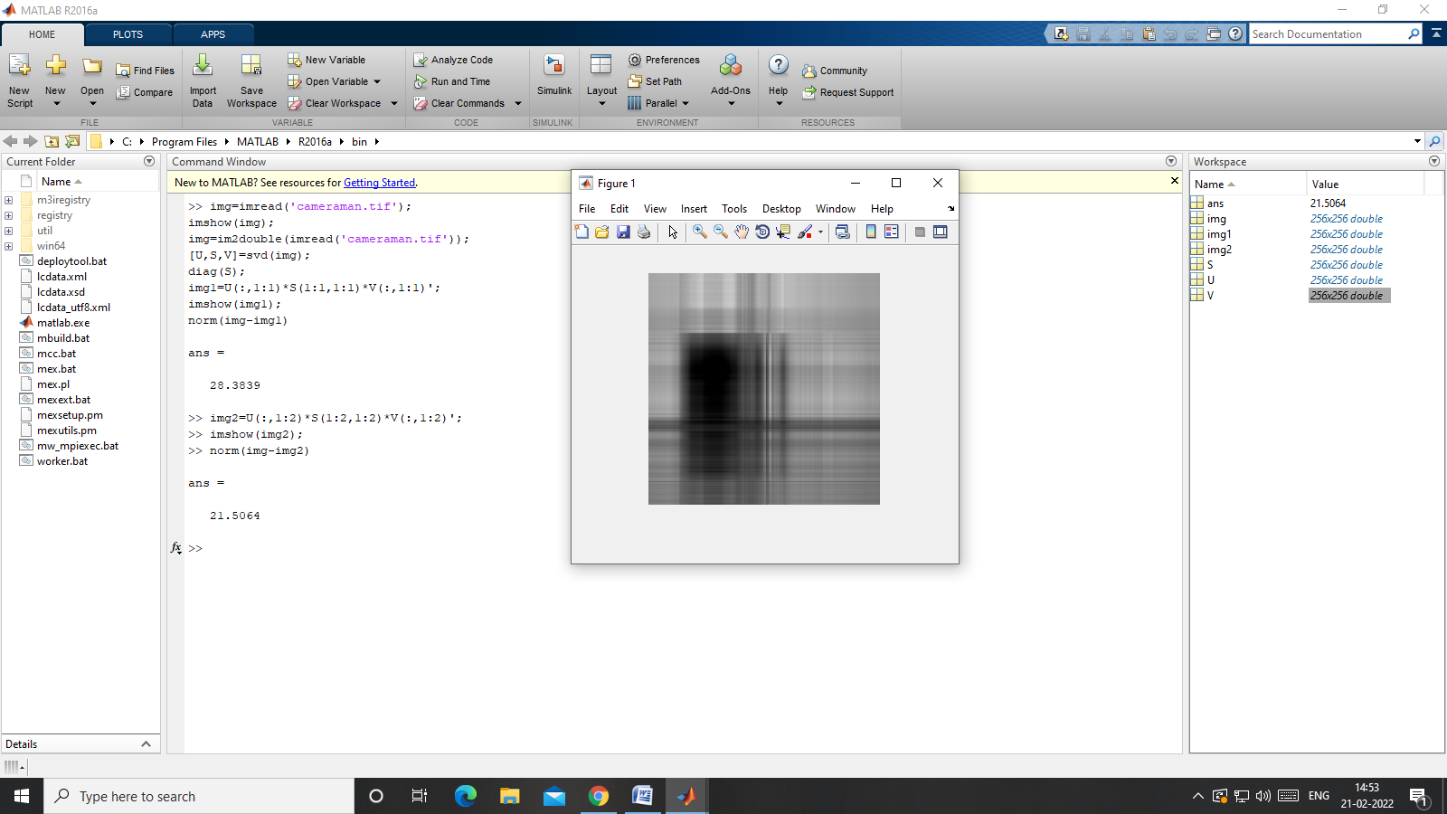
Rank(img) = 2, (k=2)

Slide 22

Rank(img) = 2, (k=2)

Slide 23
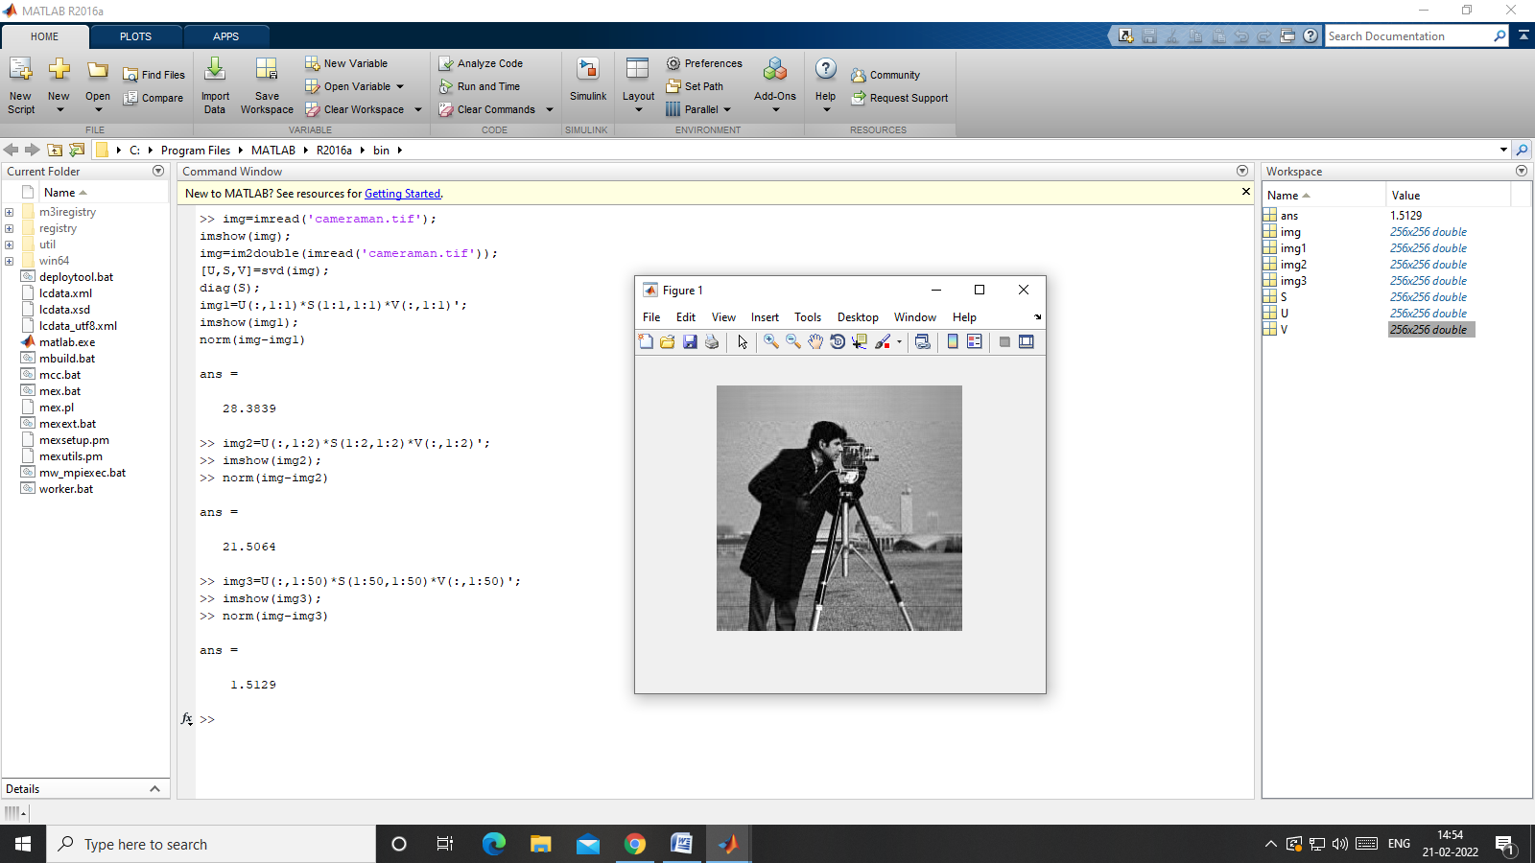
Rank(img) = 50, (k=50)

Slide 24

Rank(img) = 50, (k=50)

Slide 25
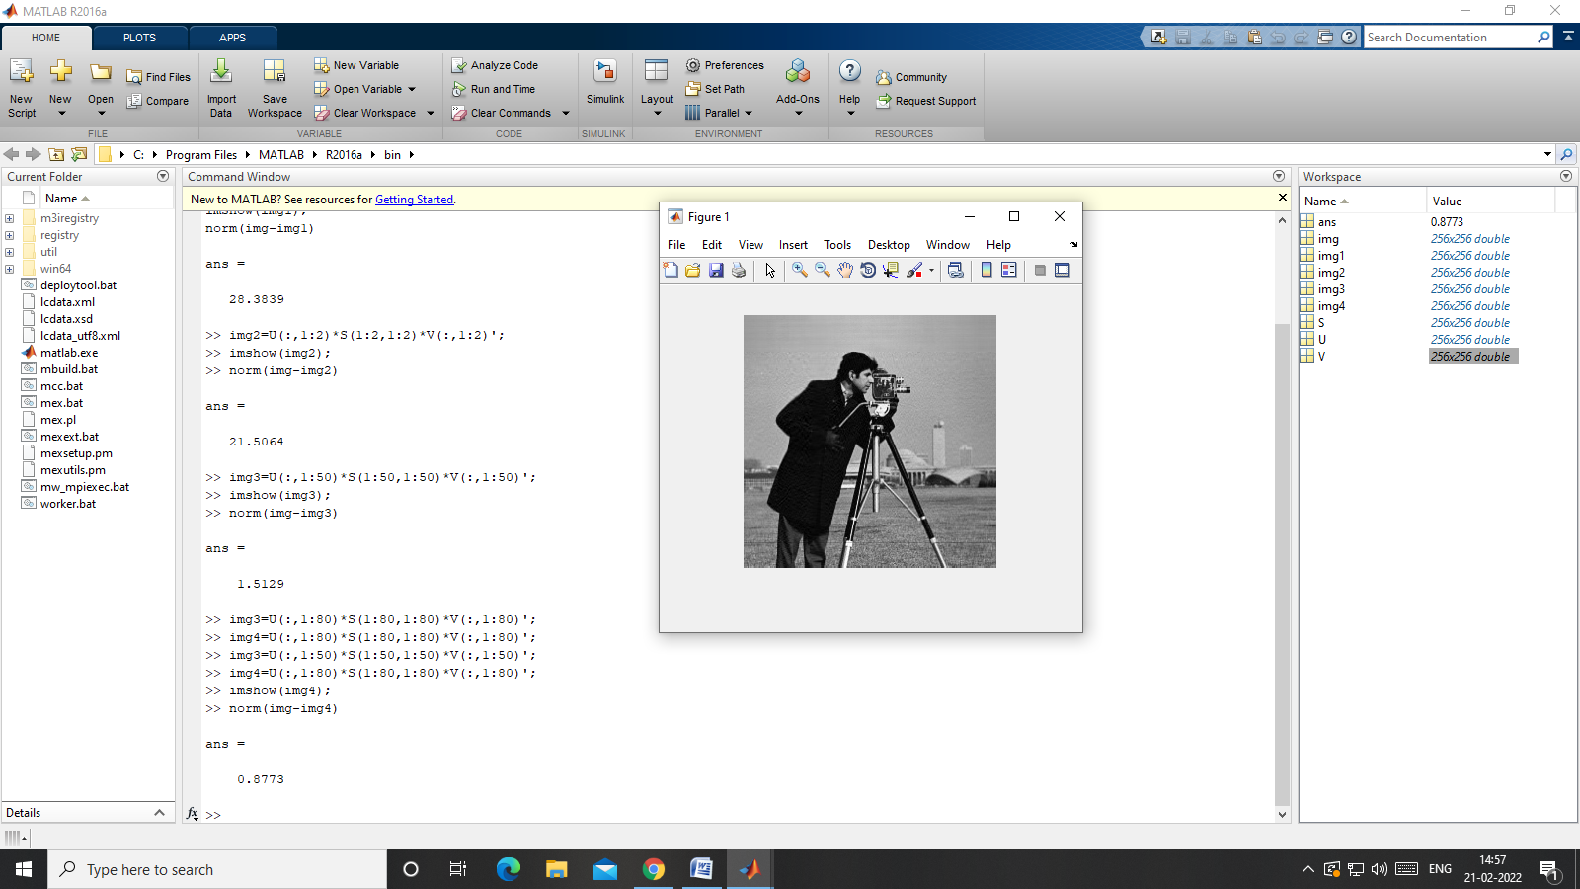
Rank(img) = 80, (k=80)

Slide 26

Rank(img) = 80, (k=80)

Slide 27
Quality of Compressed Image
The quality of a compressed image refers to how closely it resembles the original uncompressed image.
It is a measure of how much information has been retained or lost during the compression process.
Following methods are used to measure the quality of the compressed image.
Euclidean Norm -
Root Mean Square Error (RMSE)
Signal to Noise Ratio (SNR)
Peak Signal to Noise Ratio (PSNR)

Slide 28
Quality of Compressed Image
contd.,
(i). When rank (img) = 1, norm( img - img1) = 28.3889
(ii). When rank (img) = 2, norm( img – img2) = 21.5064
(iii). When rank (img) = 50, norm( img – img3) = 1.5129
(iv). When rank (img) = 80, norm( img – img4) = 0.8773

Slide 29
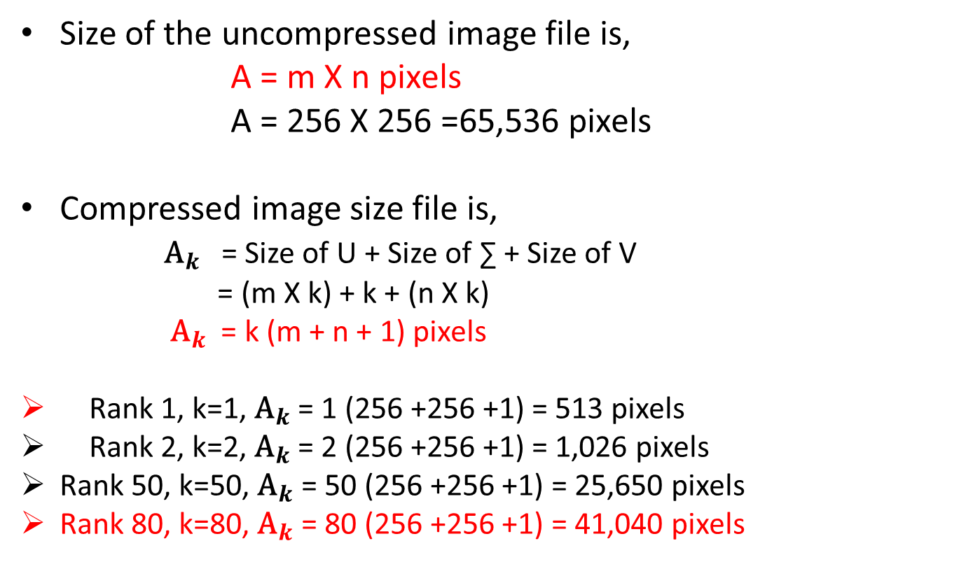
Compressed Image File Size
Size of the uncompressed image file is,
A = m X n pixels
A = 256 X 256 =65,536 pixels
Compressed image size file is,
${\text{A}}_{k}$ = Size of U + Size of ∑ + Size of V
= (m X k) + k + (n X k)
${\text{A}}_{k}$ = k (m + n + 1) pixels
Rank 1, k=1, ${\text{A}}_{k}$ = 1 (256 +256 +1) = 513 pixels
Rank 2, k=2, ${\text{A}}_{k}$ = 2 (256 +256 +1) = 1,026 pixels
Rank 50, k=50, ${\text{A}}_{k}$ = 50 (256 +256 +1) = 25,650 pixels
Rank 80, k=80, ${\text{A}}_{k}$ = 80 (256 +256 +1) = 41,040 pixels

Slide 30
References
“Linear Algebra and Its Applications”, David C Lay, Steven R Lay, Judi J McDonald.
“Optimal Singular Value Decomposition Based Big Data Compression Approach in Smart Grids”, Naser Hashemipour, Jamshid Aghaei, Abdollah Kavousi-fard, Taher Niknam, Ladan Salimi, Pedro Crespo del Granado, Miadreza Shafie-Khah, Fei Wang, João P. S. Catalão, 2021, IEEE Transactions On Industry Applications.
“Image Compression using singular Value Decomposition”, Samruddhi Kahu, Reena Rahate, 2013, International Journal of Advancements in Research and Technology.
“Recommendation System Based on Singular Value Decomposition and Multi-Objective Immune Optimization”, Zheng-yi Chai, Ya-lun Li, Ya-min Han, And Si-feng Zhu, 2019, IEEE Access.

Slide 31
THANK YOU

